Slide 1
Algorithmic Trading for NVIDIA
By: Jeff, Exzavier, Nipun

Slide 2
Project Description
We will start with training a logistic regression model to NVDA stock data pulled from YFinance. We will be calculating the daily returns using the closing prices, defining short and long windows (50 and 100 respectively) to calculate the SMA. Once this is done we will then create buy and sell signals as well as training the model to identify those buy and sell signals based on our set parameters. After we train the data we will scale it and create a classification report to determine accuracy of the model we are using. After observing the f1 scores, we will calculate and plot the cumulative returns for the actual and trading algorithm returns. we will compare the logistic regression to the SVM to determine if there were any changes ito the f1 scores. We used the TA_lib library for this project to help calculate the RSI and Ichimoku Cloud indicators to observe if these are better at predicting buy and sell opportunities than the trading signals generated based off the daily returns. We pull the data as before and plot the close price in a chart to visualize it. RSI will be calculated using the pulled data and the Ichimoku cloud will be created by adding in the 5 lines of Tenkan, Kijun, Senkou span A, Senkou span B and Chikou Span B.
Notes:
N

Slide 3
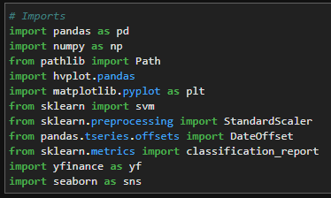
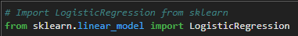
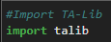
Importing Data
To install yfinance you must 'pip install yfinance' For the Ichimoku Cloud and RSI you must import the TA library by 'import talib' but first you need to make sure it is installed. To install it you must use '$ conda install -c conda-forge ta-lib' in the gitbash terminal.
The reason we used finance was to import the historical stock data for NVDA without needing to download a CSV. We also used it since it was more convenient when calculating the RSI which will be covered later.
All the other imports we have learned in class such as pandas, numpy, hvplot, sklearn, seaborn.
Notes:
E

Slide 4
Data Preparation
Import the NVDA dataset into a Pandas Dataframe from 8/31/20 to 8/31/23
Calculate daily returns using closing prices
-
Drop null values
-
Notes:
J

Slide 5
Data Preparation
Define short and long windows and assign them to appropriate columns
-
-
-
Drop nulls
Assign copy of sma-fst and sma_slow to X
-
Notes:
N

Slide 6
Data Preparation
Create a signal column
-
Create buy signal
-
Create Sell signal
-
Copy new signal column to a new series ‘y’
-
Notes:
E

Slide 7
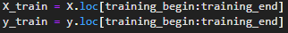
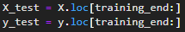
Data Training
Set start and end dates for data training
-
-
Generate X and y train dataframes
-
Generate X and y test dataframes
–
Notes:
J

Slide 8
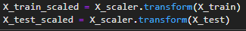
Data Scaling
Create standard scaler
-
Apply it to fit X_train data
-
Transform X_train and test dataframes
-
Notes:
N

Slide 9
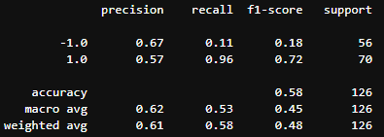
Data Analysis
Create a classifier model (SVM model)
-
Fit the model to the data
-
Predict trading signals
-
Evaluate the model
-
-
Notes:
E

Slide 10
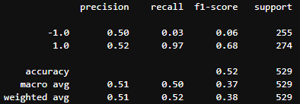
Data Analysis
Predict trade signals for testing data
-
Evaluate the model’s ability to predict the signal
-
-
Notes:
J

Slide 11
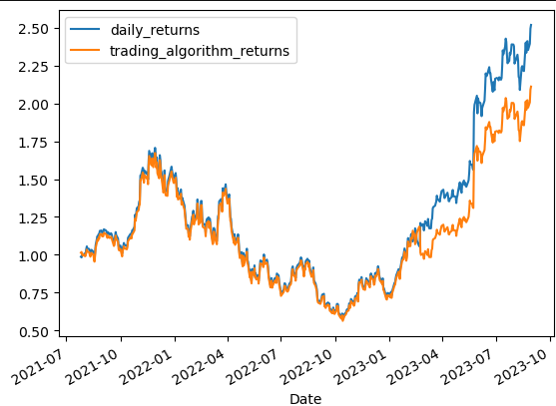
Data Analysis
Create a new empty predictions Dataframe
-
-
-
Calculate and plot cumulative returns
-
Notes:
N

Slide 12
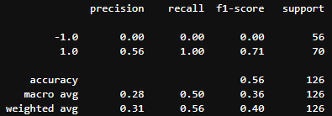
Data Analysis
Now we must create a logistic regression model
-
Fit the logistic regression model
-
Predict trading signals for the trained data
-
Generate a classification report
-
Notes:
E

Slide 13
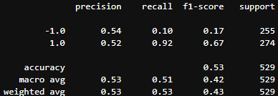
Data Analysis
Predict trading signals for the testing data
-
Generate a classification report
-
-
Notes:
J

Slide 14
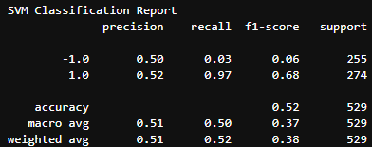
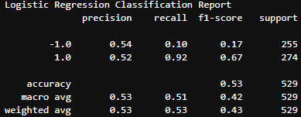
Comparing Logistic Regression and SVM Classification Reports
Logistic Regression
SVM
These figures support our hypothesis that utilizing just the daily returns / sma is not the best at identifying buy and sell points on its own.
A better combination of trade indicators would be to utilize RSI and Ichimoku cloud indicators.
Notes:
N

Slide 15
What is RSI and Ichimoku Cloud?
RSI is the relative strength index which measures the speed and magnitude of price changes and represent if the security is are overbought or oversold.
Typical an RSI value over 70 is considered overbought while an RSI value under 30 is oversold.
Ichimoku Cloud is another indicator that calculates 5 lines of short to medium duration on high/low/close prices. It will plot an area between these lines which is called the Ichimoku Cloud.
These lines will help us in determining momentum, direction and support-resistance levels for the data. Ichimoku Cloud will also create buy and sell signals using this data.
It is vital to combine technical indicators to create good trading signals. The combination of RSI and Ichimoku Cloud is a great combination since the RSI identifies momentum while the Ichimoku Cloud helps identifying the direction of the trend.
Notes:
E

Slide 16
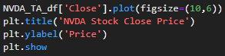
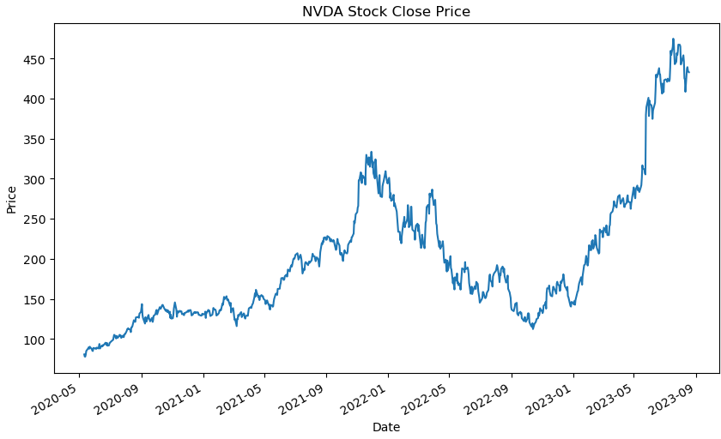
Calculate RSI
Retrieve stock price data
-
Calculate RSI
-
Plot price data to visualize close price
-
-
-
Notes:
N

Slide 17
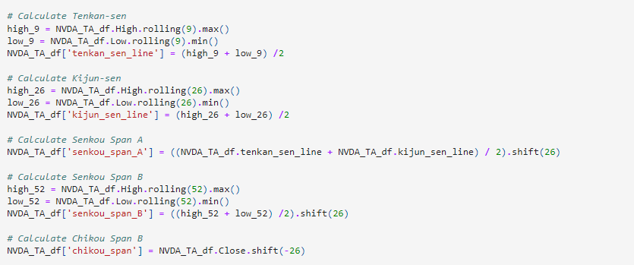
Calculate Ichimoku Cloud
Tenkan Sen or Conversion Line: (9-period-high + 9-period-low)/2
Kijun Sen or Base Line: (26-period-high + 26-period-low)/2
Senkou Sen A or Leading Span A: (Base line + Conversion Line)/2
Senkou Sen B or Leading Span B: (60-period-high + 60period-low)/2
Chikou Span or Lagging Span: (Close of 30 periods ago)
Notes:
J

Slide 18
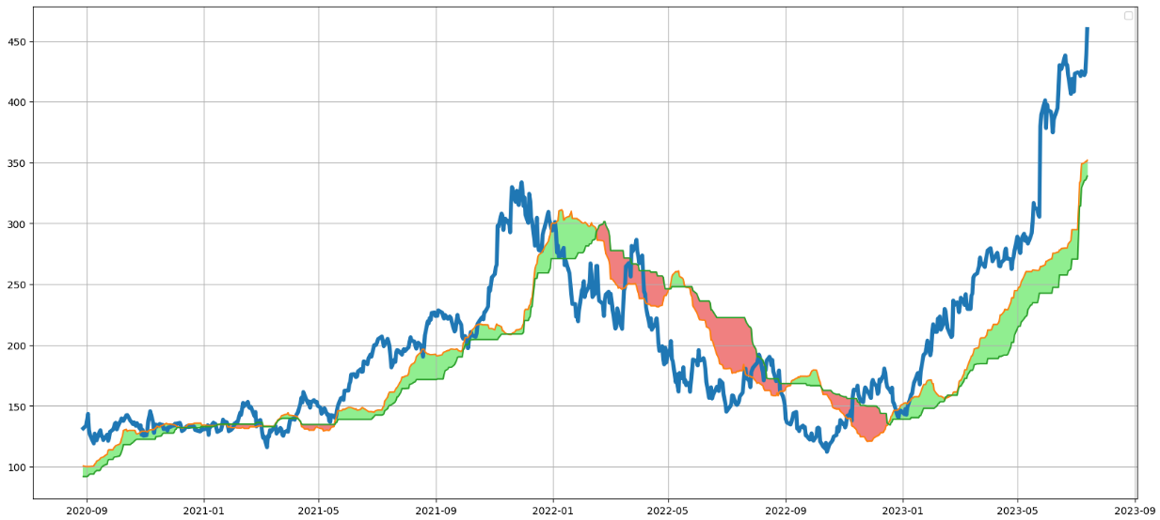
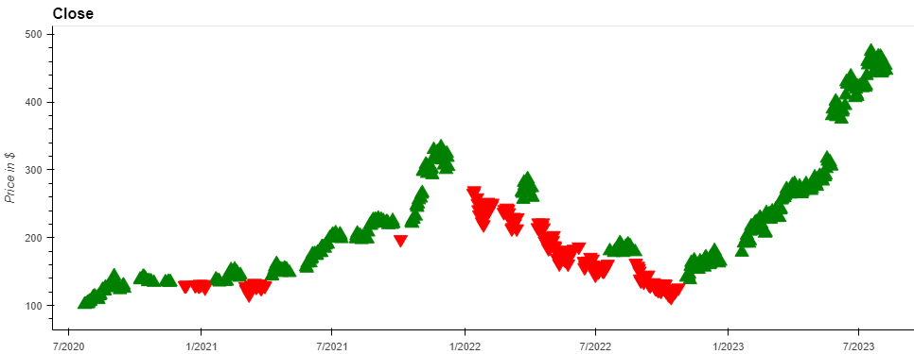
Ichimoku Cloud and what it means
Notes:
J

